Slide 1
OrderMaster
Denver Woolard, Harrison Aunspaw, Robert Sutton, Romel Miller, Lydia Clark

Slide 2
OrderMaster’s Goal
OrderMaster is a simple, intuitive program that allows owners and employees of a restaurant business to manage their orders. It also has functionality to manage servers or waiters, menu items, and tables.

Slide 3
Use Cases
Many owners of small restaurants still utilize manual methods of tracking orders. While this can be effective for smaller businesses, they can leave room for errors as demand grows, which can cause confusion within staff and potentially cost precious time or money. Applications exist to track orders, but many of them require the user to undergo specialized training or use proprietary hardware in order to use them effectively. OrderMaster is a simple, intuitive web application that can be accessed from most modern devices, cutting out the time and money needed to invest in these high upfront costs.

Slide 4
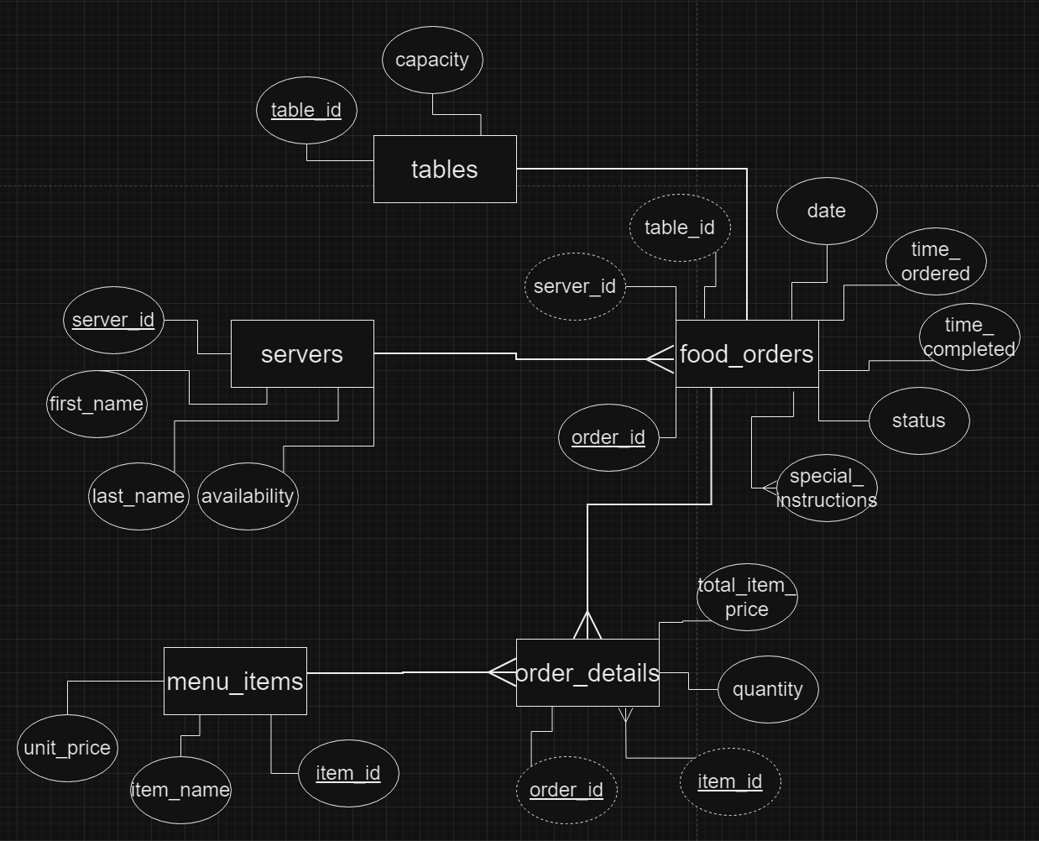

Slide 5
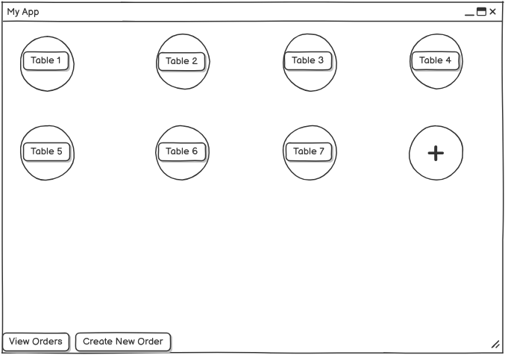

Slide 6
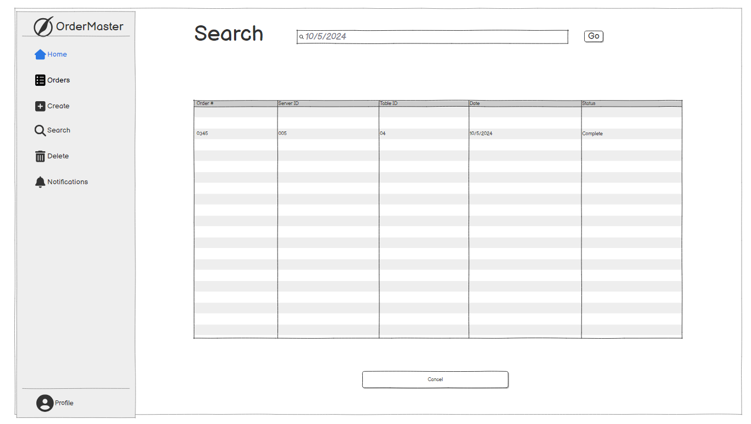

Slide 7
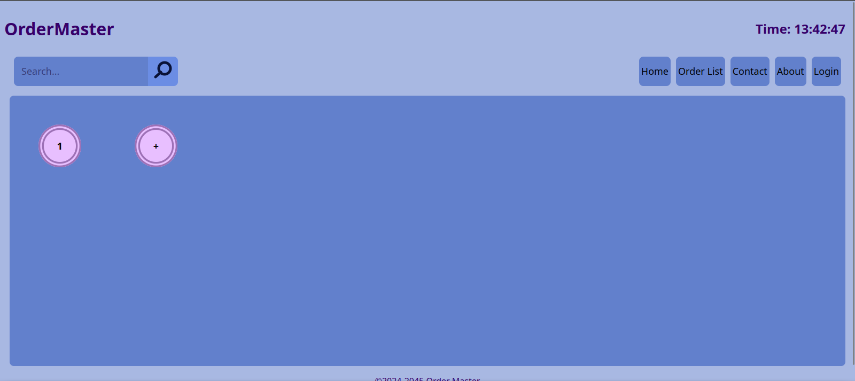
Homepage
Tables are represented here – the user can click on a table to go to its current active order

Slide 8
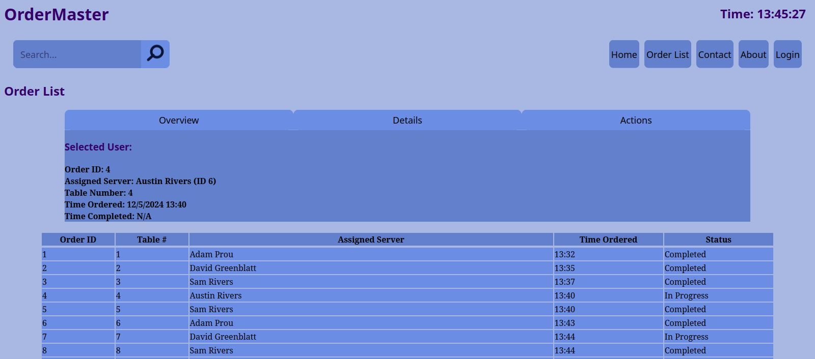
Order List
The main page that users will access. Allows control over registered orders.
Once an order is clicked, information can be viewed here. The tabs on the top allow navigation of different tiers of actions and information.
Orders are displayed in a brief table under the order details widget

Slide 9
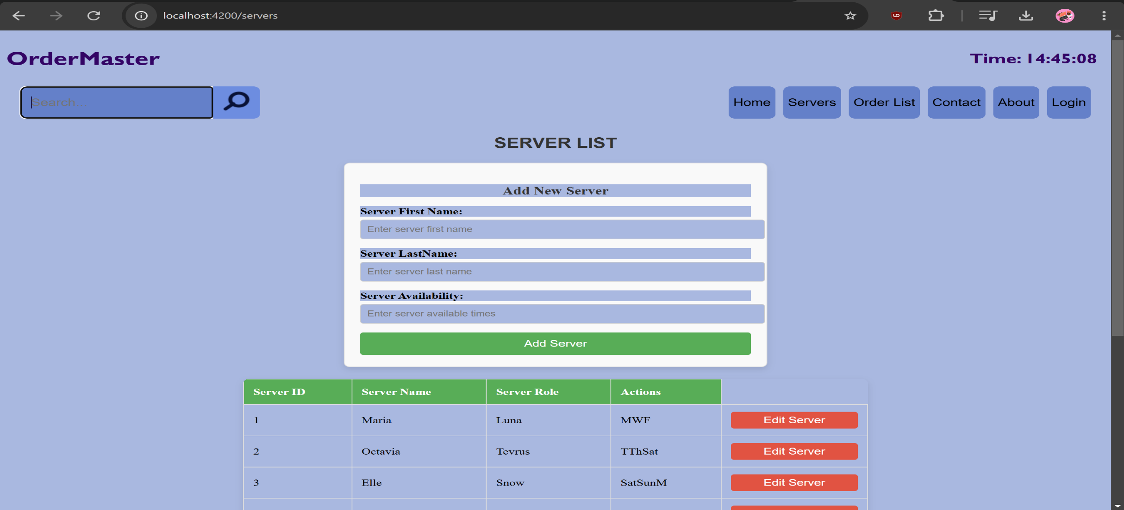
Server List
This is the main page that users will access. Allows control to add servers.
Servers are displayed in a list under the Add New Server form

